Slide 1

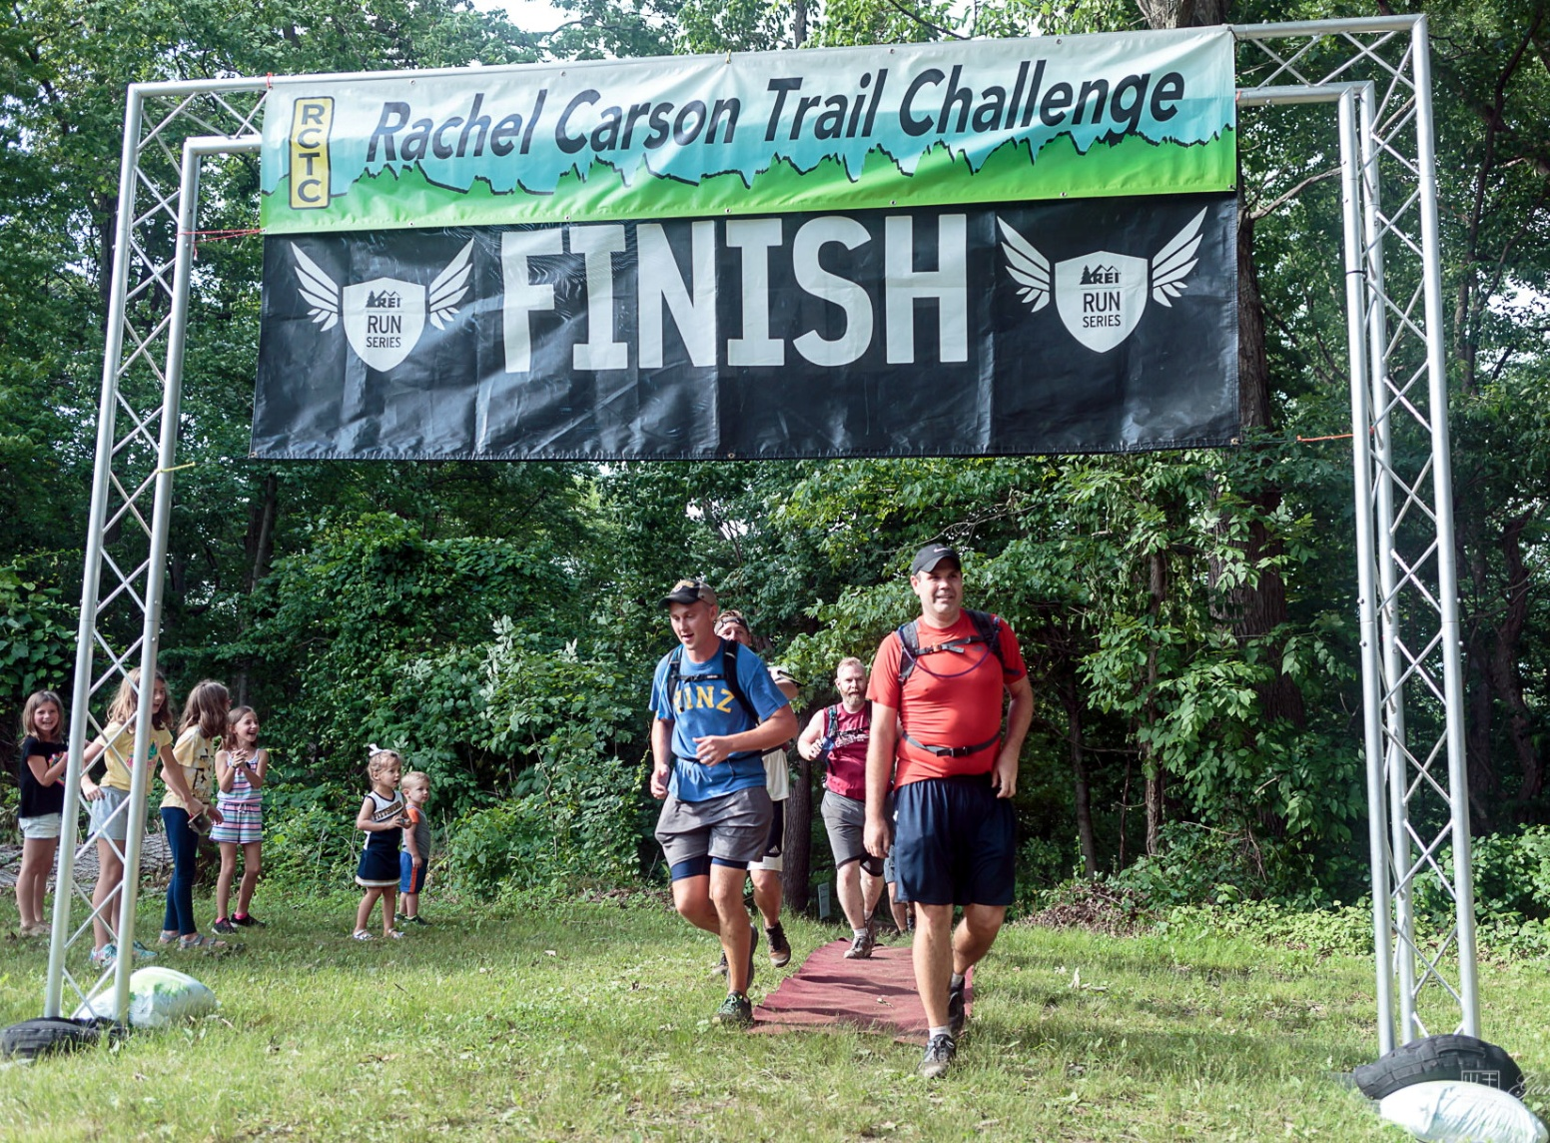
Welcome to the 2024 Rachel Carson
Trail Challenge Prep Talk

Slide 2


Thanks much to 3 Rivers Outdoor Co. for your support of the RCTC & the Challenges

Slide 3
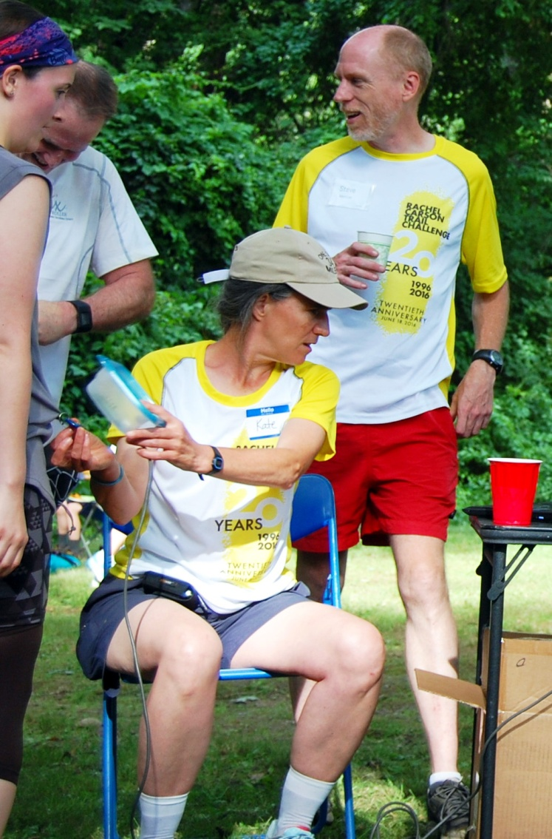
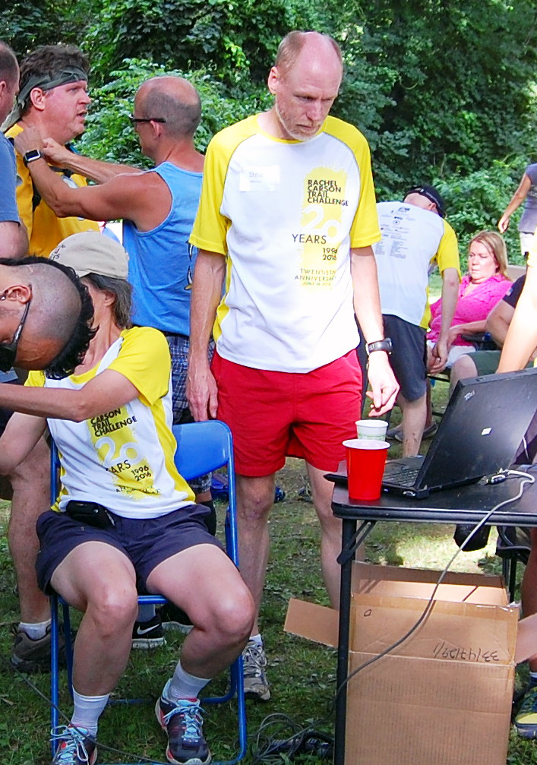
Steve Mentzer – The Life Blood of the Challenge !
Thanks Steve

Slide 4

Rachel Carson Trails Community – Who are we?
We are all volunteers
Committed to creating, maintaining, and promoting trails and getting folks outside
Maintains 180+ miles of trails in Western PA
Become a member, volunteer and donate with us https://www.rachelcarsontrails.org
Many Trails, One Community is a collaborative effort to build and enhance a network of community hiking trails throughout Western Pennsylvania. The program builds on the RCTC’s tradition of hikers creating partnerships to connect destinations and assets with walkable routes.
For more information or to join a working group please contact the RCTC Trail Development Program manager John Stephen at john.stephen@rachelcarsontrails.org or 412-606-7149.

Slide 5
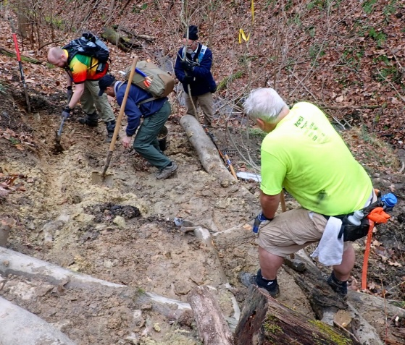
Recent: Major Trail Re-routing Activities
The Safer Trails committee explores ways to improve trail user safety, focusing on opportunities for moving trails off roads, and also identifying conflicts with trail bikes/ATVs, hunting, industry, and other hazards where remediation involves landowner permissions, licenses, easements, and/or acquisitions.
Goal – get as much of the trail off road as reasonable ( only 6.2 miles on road now)
Two areas were recently targeted:
#1) Ridge Road ( near the Bull Creek check point )
#2) Riddle Run Road ( near Agan Park Check Point )
#3) Yutes Run Road ( back side of Log Cabin Hill )
https://www.rachelcarsontrails.org/events <← Check for schedules

Slide 6
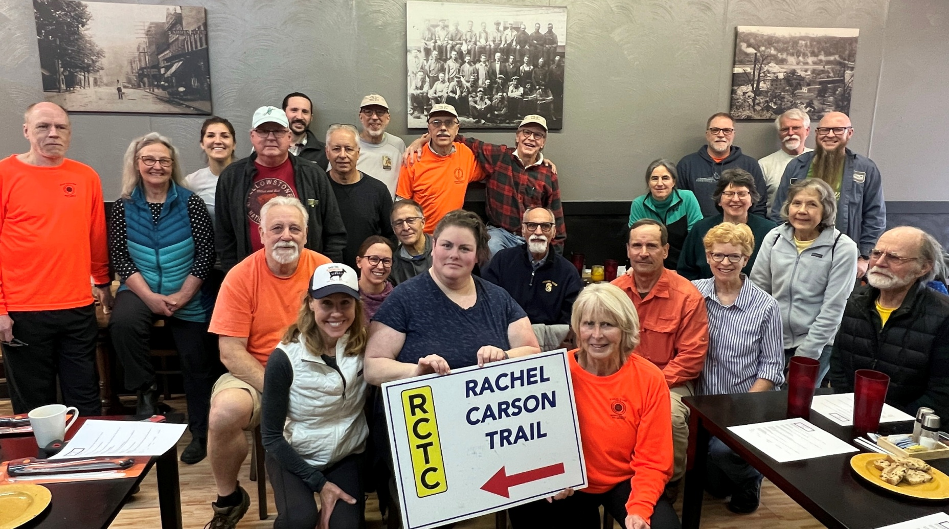
Our Trail Stewards &
Other Volunteers :

Slide 7
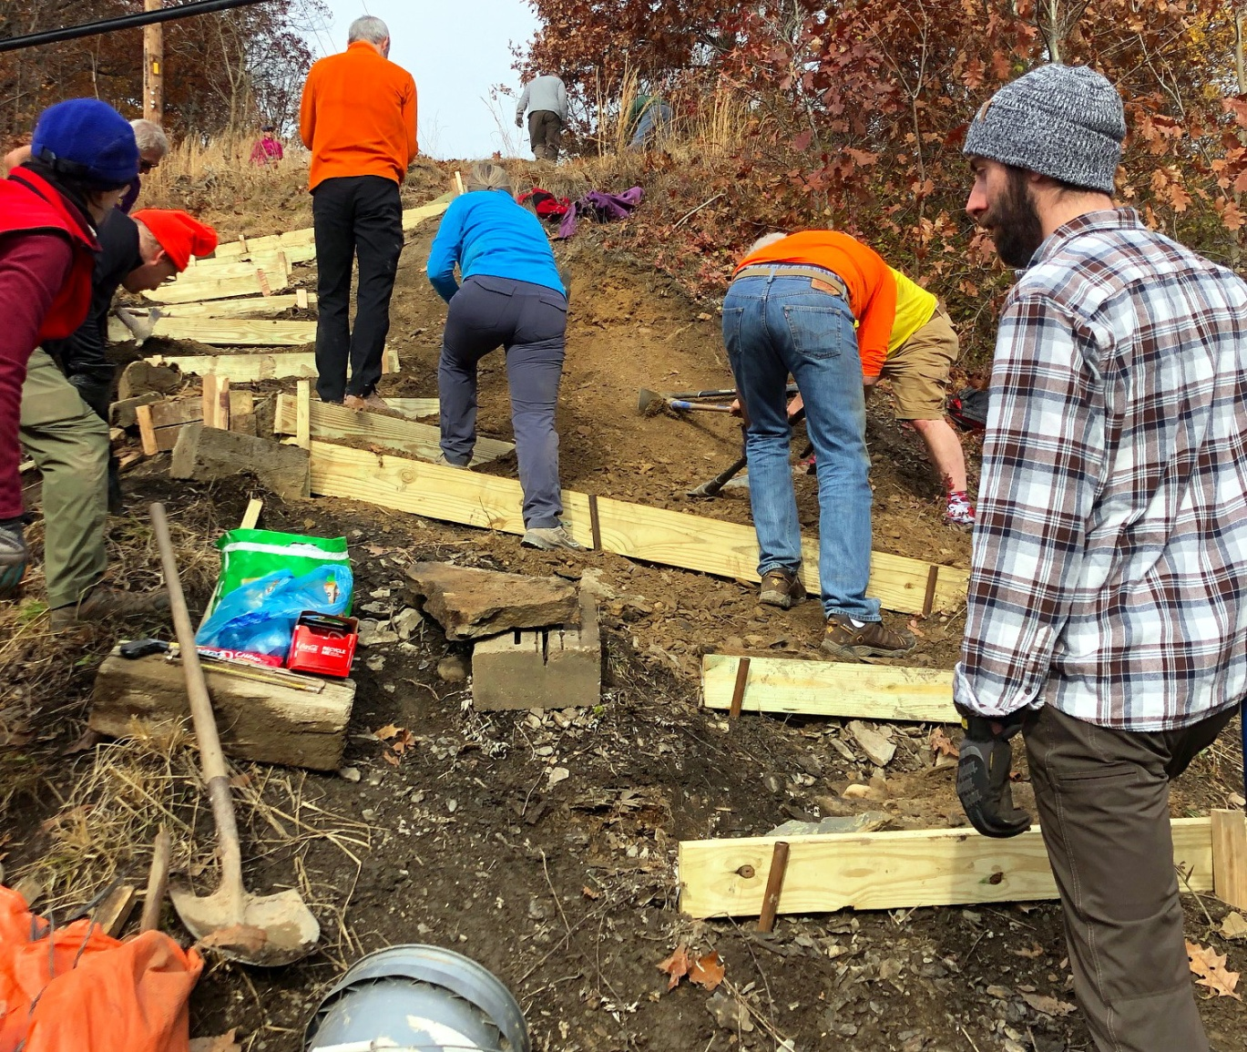
Trail Project Work:

Slide 8
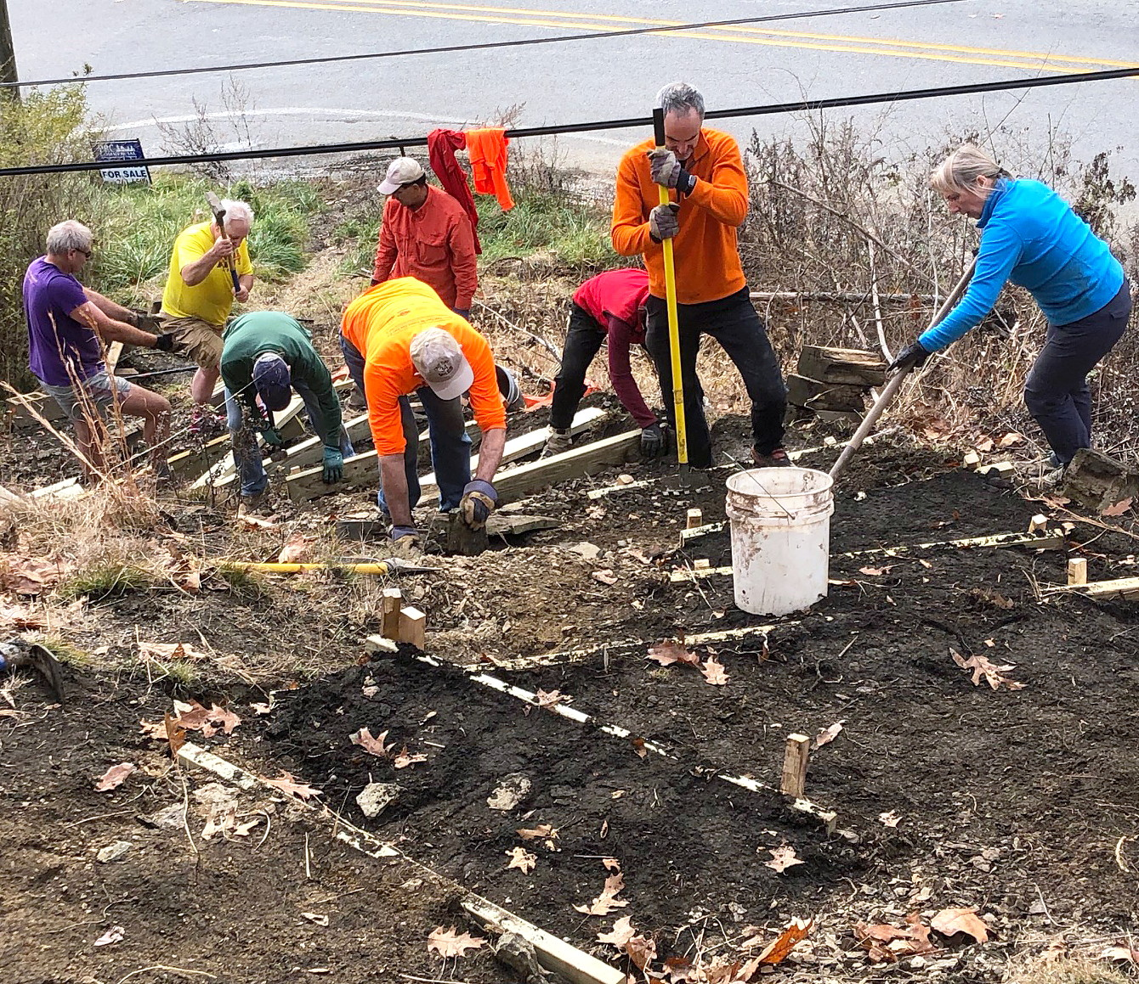
Trail Project Work:

Slide 9
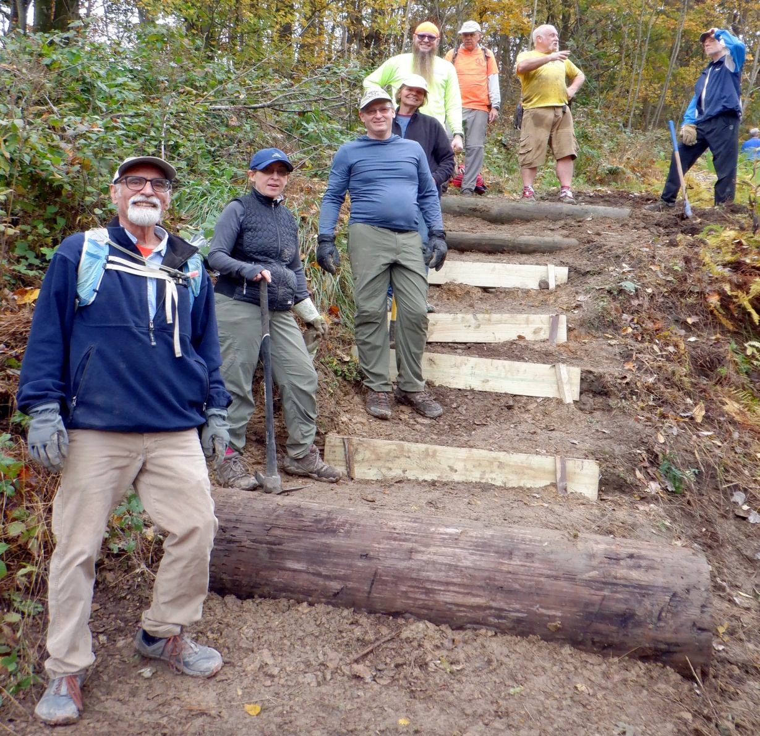
Trail Project Work:

Slide 10
Choose From the three events !
https://my.rachelcarsontrails.org/events
Choose which event is right for you:
  The Full Challenge (36+ miles)
  The Homestead Challenge (17+ miles)
  Friends & Family Challenge (8 ^{+/-} miles)
Register
Pay the registration fee, secure your place, and wonder what you just got yourself into!
Notes:
Open the floor to questions about who has or has not registered. We can check with Steve to see what are numbers are at by the time of the talk.

Slide 11
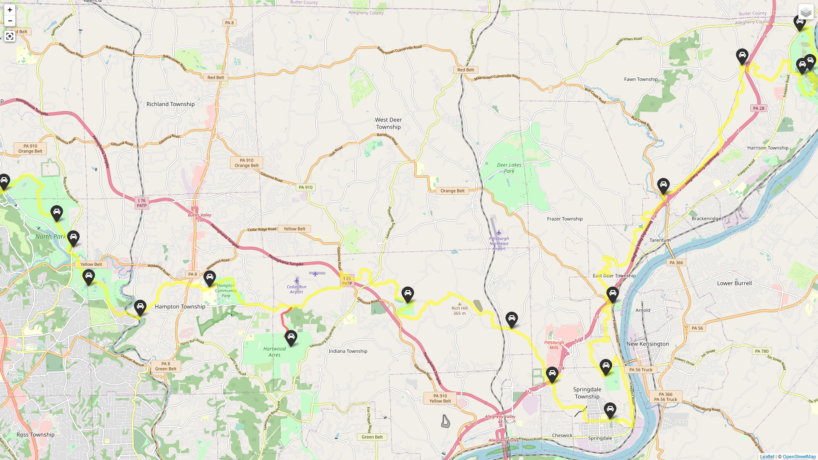

Slide 12
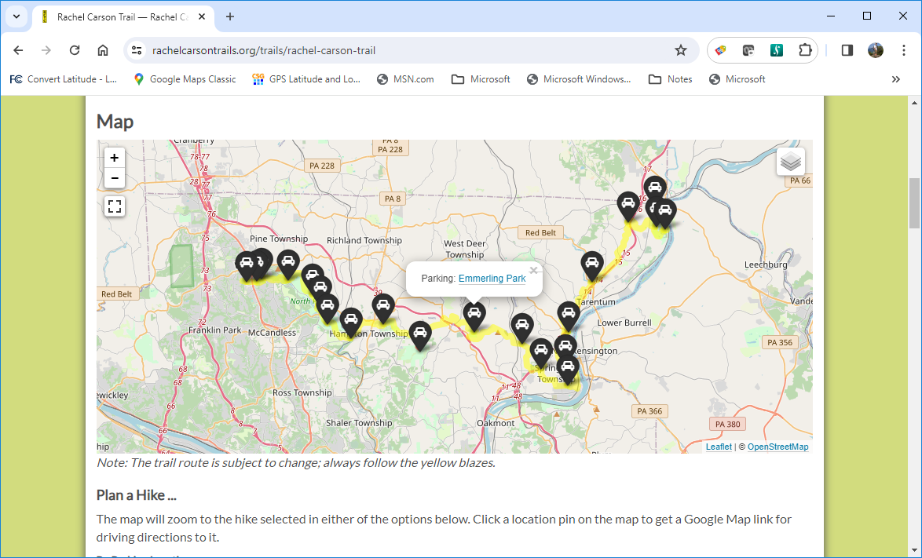

Slide 13
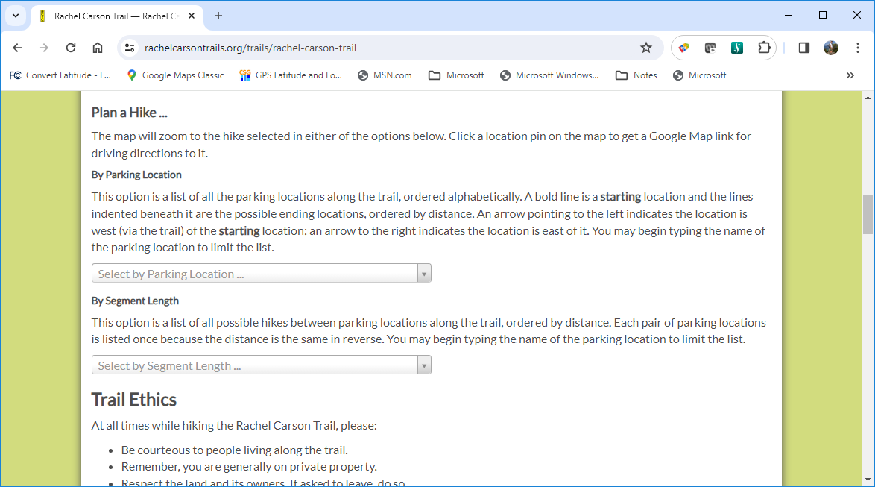

Slide 14
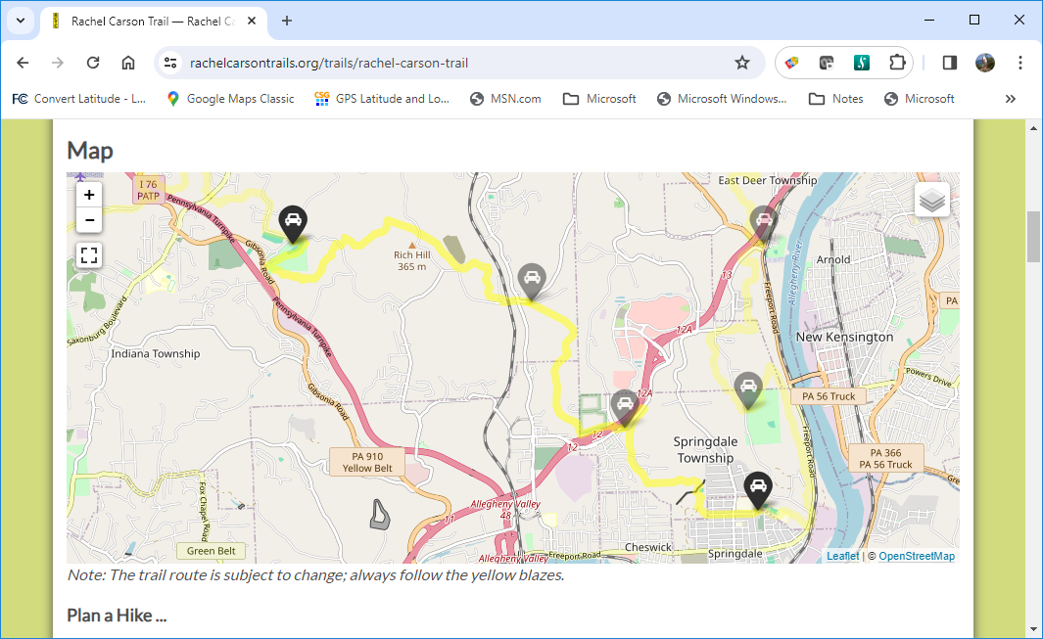

Slide 16
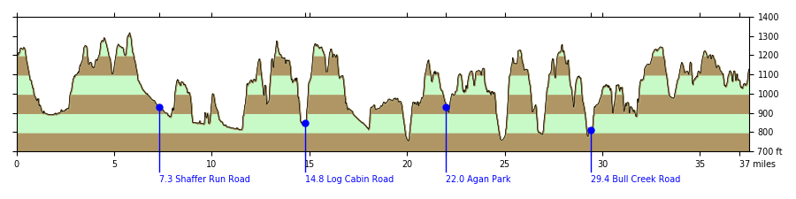
2024 Full Challenge: Elevation Profile
( 37.4 miles length / 15 hours 4 minutes )
Total Ascending 8,145 ft. Total Descending 8,208 ft.
Pace: 2.482 mph = 24 minutes 10 seconds per mile

Slide 17
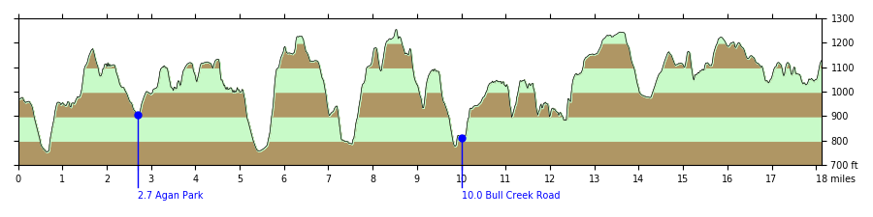
2024 Homestead Challenge: Elevation Profile
( 18.1 miles length – 7 hours 18 min. to complete )
Total Ascending 4,598 ft. Total Descending 4,446 ft.

Slide 18
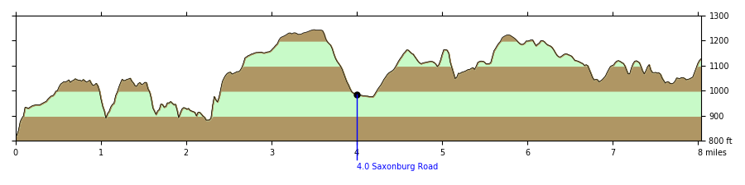
2024 Friends & Family Challenge: Elevation Profile
( 8.0 miles length – 3 hours 14 min. to complete )
Total Ascending 1,947 ft. Total Descending 1,639 ft.
You may start when all group members are present and ready, anytime between 12:00 PM and 12:30 PM. Make sure you stop at the table and let the volunteers scan your tag so we know you've left and have an accurate start time. Registration closes at 12:30 PM. 5 people for the price of one !! Great into to the Rachel

Slide 19
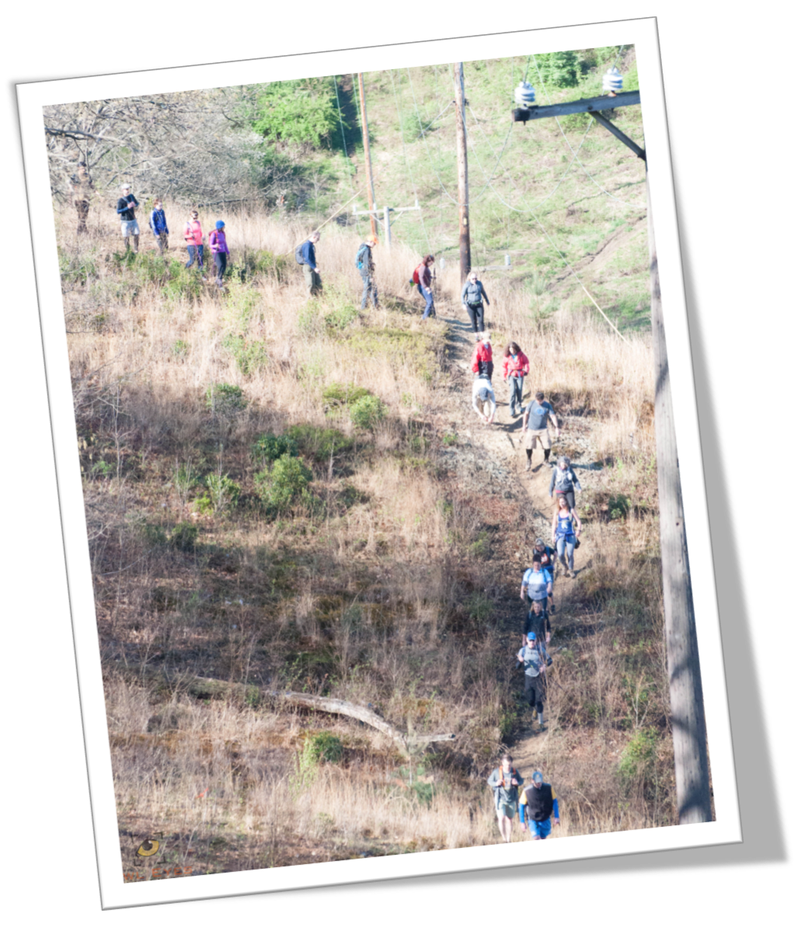
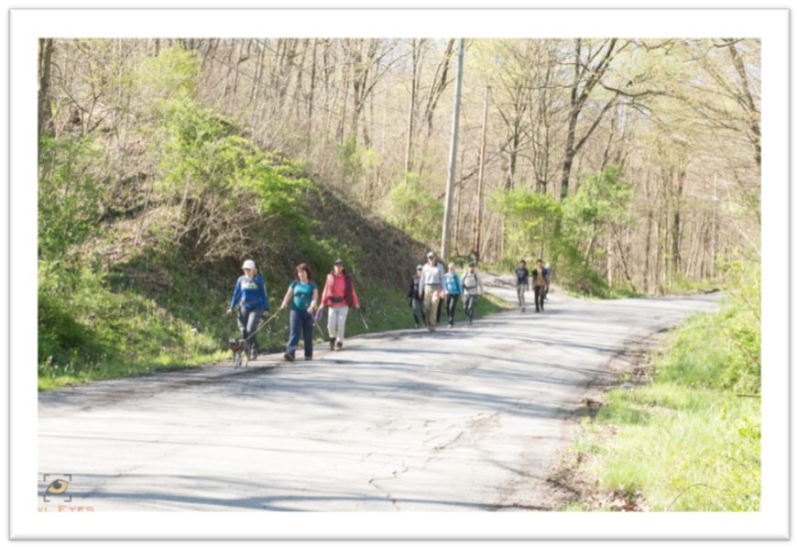
Challenge Training Hikes
Weekly hikes that increase in length over the course of two months; and replicate what you may experience on the day of the challenge – including inclement weather.
These hikes are led/swept by volunteers. Please be prepared with masks, snacks and hydration.

Slide 20
WHY the training and orientation hikes?
Get familiar with the actual trail terrain
  Hills covered in slippery shale, hills covered in mud, just all the hills
  Creeks to cross
  asphalt roads
Foliage
  High grasses
  Jagger bushes
  Poison Ivy
  Branches high and low

Slide 21
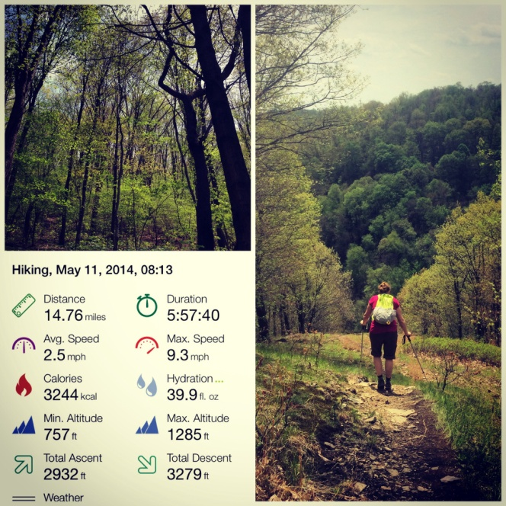
Train
  On your own
Train
  With a friend
and then train some more
  Join us for the training hikes every Sunday beginning in April
  Or at the very least one (or all four) of the Orientation hikes

Slide 22
What’s the best fuel for you?
  PB& J sandwiches vs. bagel with cream cheese
  Goo vs. Energy chews
  Gatorade vs. Smart Water
  Bananas? Oranges? Apples?
*Keep in mind: On the day of the challenge there are four check-ins with plenty of snacks, water, and Gatorade available to participants. While most our snacks are considered vegetarian, we are not able to accommodate specific dietary restrictions.

Slide 23
Chose the best equipment for you – nothing is universal!
Think Wicking / Flexible / Light Weight
Trekking Poles or not / hats / short or long pants
Hydration Pack vs water bottle
Test your gear
  Hiking Boots vs trail running shoes
  Trekking poles vs a walking stick vs free hand
  Hiking pants, cargo shorts, scrubs, yoga leggings, and yes even jeans
  Hydration Packs vs. Water Bottles

Slide 24
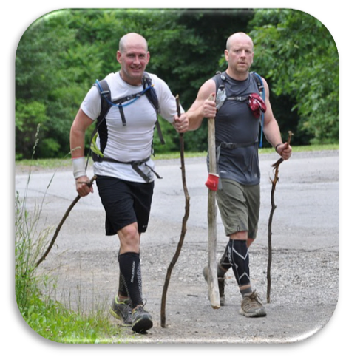
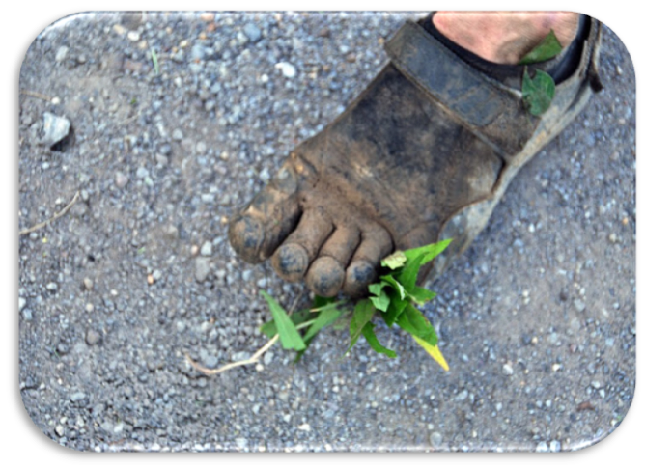
Good gear is whatever works best for someone !
  Hopefully you were breaking in your shoes with all that training. It’s best not to wear brand new shoes on the day of the event.
  Most people wear lighter more breathable trail shoes over older style heaving hiking boots.
  Trekking poles vs a walking stick vs free hand
  Sock Options: thick, thin, smart wool, poly-blend
  Hiking pants, cargo shorts, scrubs, yoga leggings, and yes even jeans
  Hydration Packs vs. Water Bottles
Notes:
Discuss the examples we have brought in the room

Slide 25
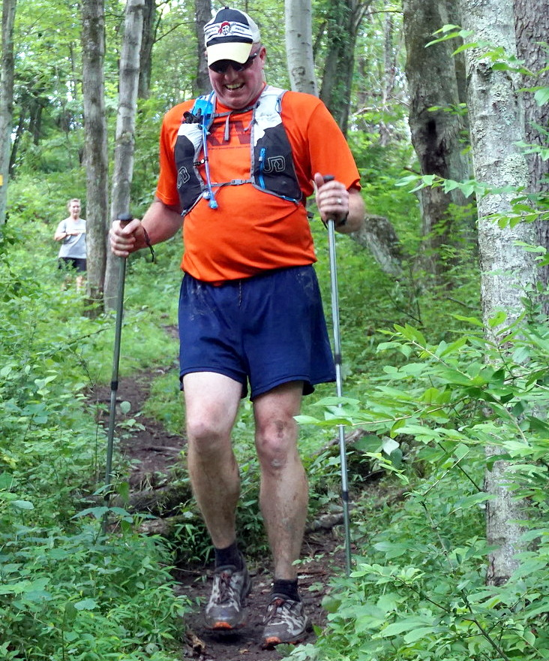
Gear -- Gear -- Gear
Hat / Hydration Pack / Poles / Shoes / socks / shorts / shirt - light & wicking

Slide 26
2024: Orientation Hikes (8 Goal Training Hikes) / 2024 Challenge: 37.4 miles in 15 hours and 4 minutes.
( 2.482 mph = 24 min 10 sec / mile ) / Total Ascending = 8,145 feet / Total Descending = 8,208 feet. https://www.rachelcarsontrails.org/events/challenge/rctc24/goaltraining
Sunday April 21st. Approximately 8.0 miles. Elevation Change: Climb 1,949 ft. Descend 1,638 feet
Bull Creek Road to Harrison Hills Park ELC Duration = 3 hours and 6 minutes at pace
Sunday April 28th. Approximately 8.7 miles. Elevation Change: Climb 1,889 ft. Descend 1,752 feet
Emmerling Park to Springdale High School Duration = 3 hours and 17 minutes at pace
Sunday May 5th. Approximately 10.1 miles. Elevation Change: Climb 2,656 ft. Descend 2,816 feet
Springdale High School to Bull Creek Road Duration = 4 hours and 14 minutes at pace
Sunday May 12th. Approximately 13.7 miles. Elevation Change: Climb 3,212 ft. Descend 3,616 feet
Eastern Terminus Crawford Run Road Duration = 5 hours and 32 minutes at pace
Sunday May 19th. Approximately 14.8 miles. Elevation Change: Climb 2,683 ft. Descend 3,036 feet
North Park Harmar to Log Cabin Road Duration = 5 hours and 35 minutes at pace
Sunday May 26th. Approximately 14.1 miles. Elevation Change: Climb 3,120 ft. Descend 3,200 feet
Emmerling to Crawford Run Road Duration = 5 hours and 40 minutes at pace.
Sunday June 2nd . Approximately 19.4 miles. Elevation Change: Climb 3,546 ft. Descend 3,776 feet
North Park Harmar to Springdale High School Duration = 7 hours and 27 minutes at pace.
Sunday June 9th. Approximately 18.7 miles. Elevation Change: Climb 4,541 ft. Descend 4,563 feet
Emmerling Park to Bull Creek Road Duration = 7 hours and 49 minutes at pace.

Slide 27
2024: Orientation Hikes (8 Goal Training Hikes) / 2024 Challenge: 37.4 miles in 15 hours and 4 Min
(2.482 mph = 24 min 10 sec / mile ) / Total Ascending = 8,145 feet / Total Descending = 8,208 feet.
This series of training hikes is intended to prepare you to take on the Challenge on Saturday June 22. These hikes not only help you build your endurance, but they also allow you to field test your gear. Your new shoes or pants may seem fine on your ten mile hikes, but only when you approach 20 miles over hilly terrain do previously imperceptible problems become incapacitating.
Everyone is welcome on these hikes; you do not need to be entered into the Challenge to participate.
These hikes are strenuous. The objective is to train you to be able to complete the Challenge within the allotted time, so leaders will be maintaining an average pace of about 2.4 miles per hour, or a little over 25 minutes per mile.
There's no need to notify the hike leader of your plan to attend. Simply show up on time.
Please bring at least a quart of water (more if the temperature will be warm) and some energy snacks (e.g. Powerbar).
Minimum unaccompanied age is 12.
We will meet at the hike end point and carpool to the start point, leaving a sufficient number of cars behind to carry people back to the start when the hike is over.
Although dogs are wonderful, please don't bring them on these hikes.
All hikes meet at 8 AM. Plan for later hikes to take up to nine hours (including sign-in, announcements, car shuttling, and so forth).
The hikes are free. A suggested donation of $3 per person may be given to the hike leader.

Slide 28
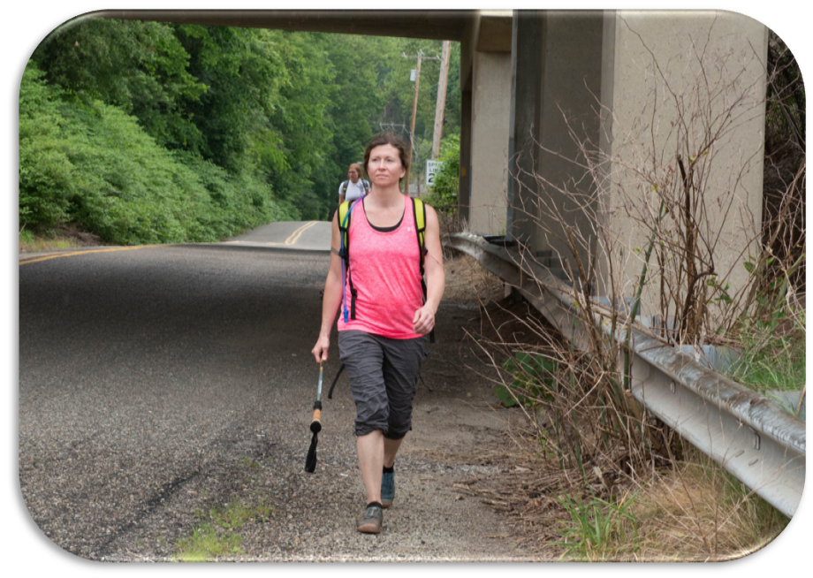
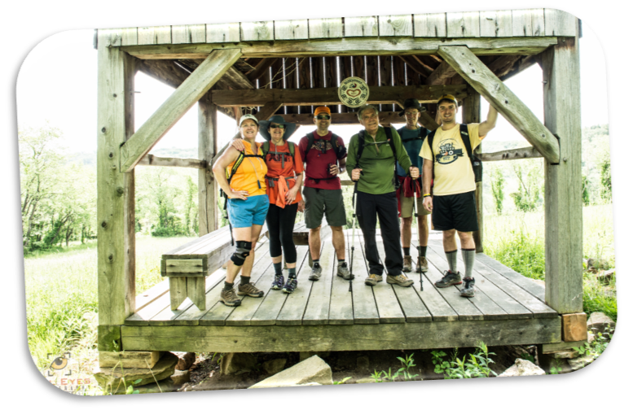

Barb Peterson Memorial Orientation Hikes
The Barb Peterson Memorial Trail Orientation Hikes are a series
of hikes over the course of two weekends prior to the challenge; and traverse the route you will encounter on the day of the event. If you’ve been training on your own, this is an opportunity to get some time on the actual trail
– never a bad thing.
Similar to the goal training hikes – these are not supported, other than the leads and the sweeps; and can be strenuous. BE PREPARED.

Slide 29
2024 Barb Peterson Trail Orientation Hikes -- over two weekends https://www.rachelcarsontrails.org/events/challenge/rctc24/orientation
On this Barb Peterson Memorial Trail Orientation series of hikes, we will prepare for the Challenge by tracing the route just as you will encounter it on Saturday June 22.
All hikes meet at 8 AM. Plan for each hike to take 6 hours (up to 4 hours for the hike plus up to 2 hours for sign-in, announcements, car shuttling, and so forth).
Saturday June 1st. Approximately 10.8 miles. Elevation Change: Climb 1,663 ft. & Descend 2,030 ft.
North Park Harmar to Emmerling Park ( 3 hours 53 minutes duration at pace )
Sunday June 2nd. Approximately 8.7 miles. Elevation Change: Climb 1,889 ft. & Descend 1,752 ft.
Emmerling Park to Springdale High School ( 3 hours 17 minutes duration at pace )
Saturday June 8th. Approximately 10.1 miles. Elevation Change: Climb 2,656 ft. & Descend 2,816 ft.
Springdale High School to Bull Creek Road ( 4 hours 14 minutes duration at pace )
Sunday June 9th. Approximately 8.0 miles. Elevation Change: Climb 1,949 ft. & Descend 1,638 ft.
Bull Creek Road to Harrison Hills Park ELC ( 3 hours 06 minutes duration at pace )

Slide 30
Major Goal: Staying on the trail without getting lost.
Trail Blazes -- are the means ( 2” X 6” rectangles generally )
Obviously, those who have hiked the trail before will have some advantage in maintaining the proper route. (Training hikes covering various sections and the entire trail are held beforehand).
While the Rachel Carson Trail is blazed with yellow blazes, there will be an occasional missing blaze where a tree has fallen or when you are following a logging road, a power line or gas line; there will be blow downs, washouts, loose gravel and rocks, gullies, and wet stream crossings.
Appalachian Trail uses white blazes
North Country Trail uses blue blazes

Slide 31
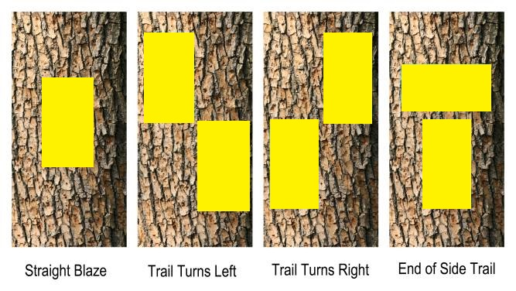
Rachel Carson Blazes are in yellow !

Slide 32
Trail Blazes:

Slide 33
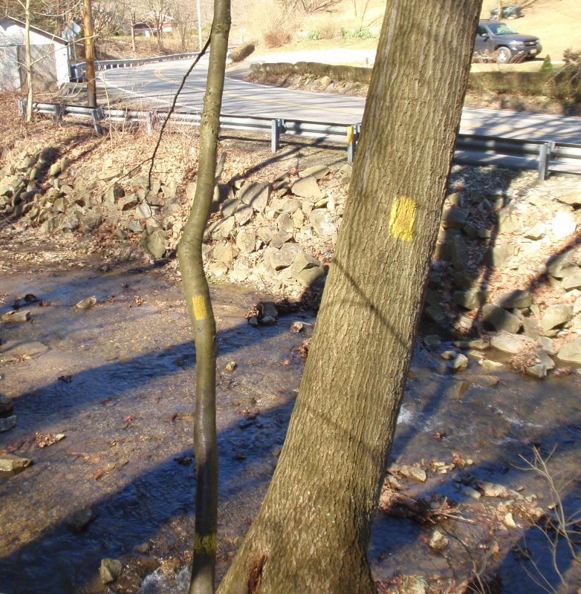
Creek Blazes – proceed straight across creek

Slide 34
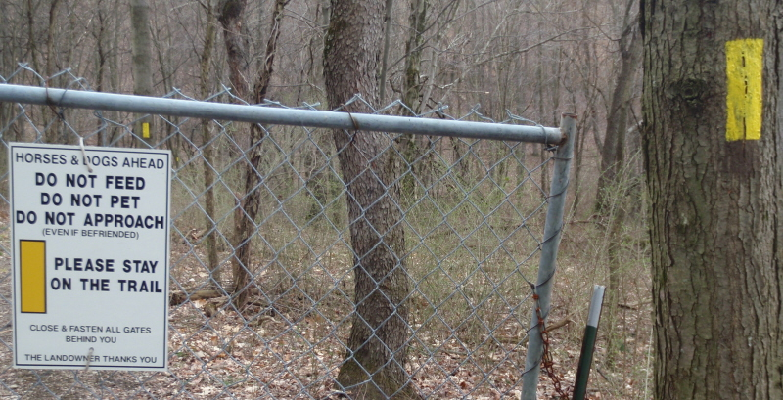
“Horse” blaze – go straight

Slide 35
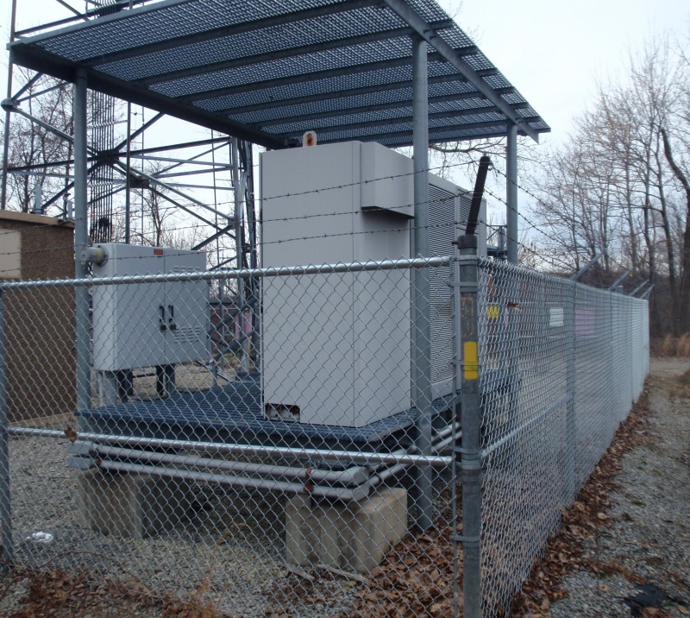
Tower blaze

Slide 36
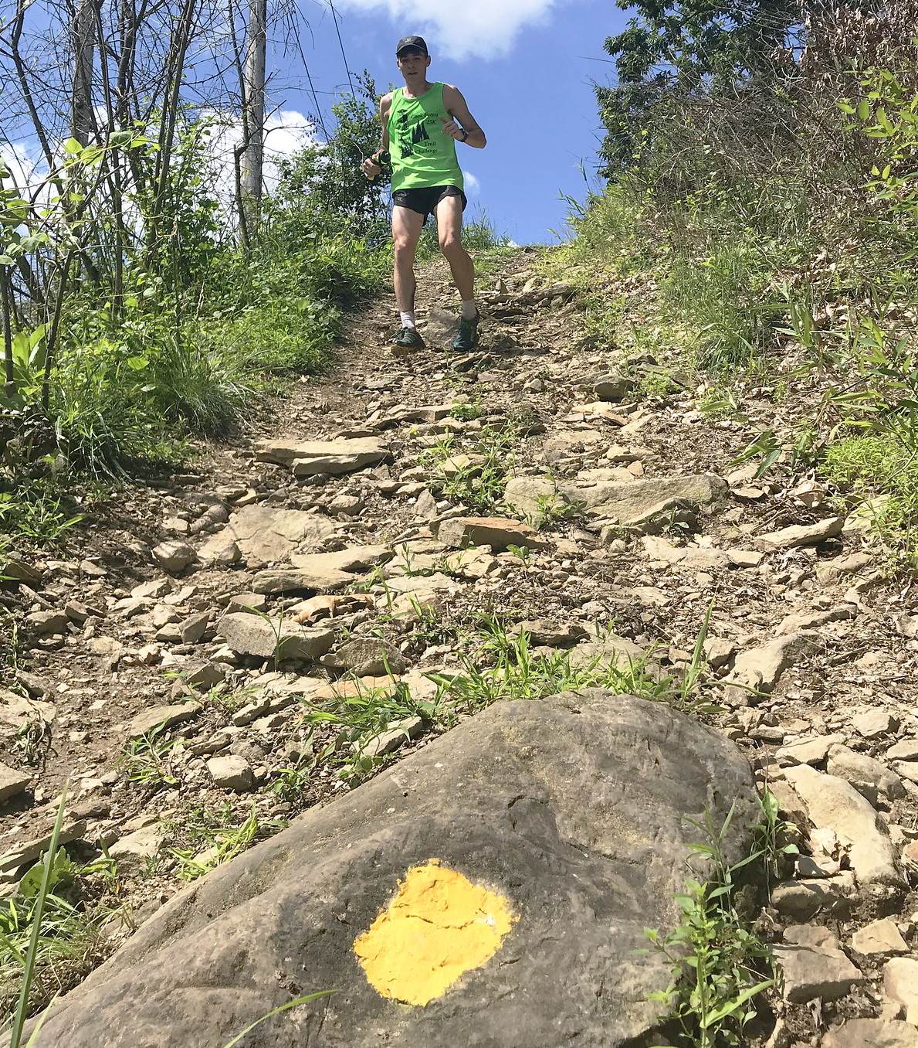
A Ground blaze - near the last check point in 2022

Slide 37
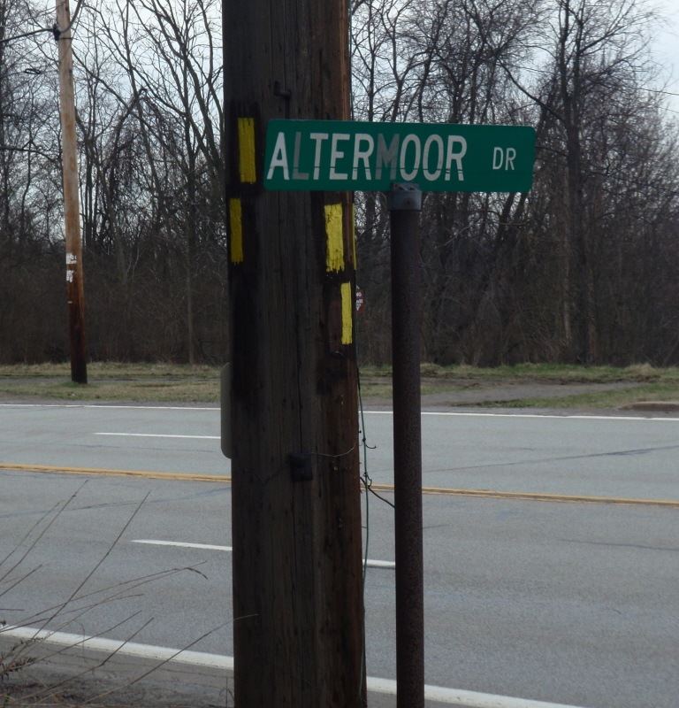
Left or Right Turn Depending on Where Coming From

Slide 38
The Day Before the challenge
  HYDRATE – no matter the weather
  Eat Well (carb loading is a thing)
  Pack your bag, check your gear
  Get a good night’s rest

Slide 39
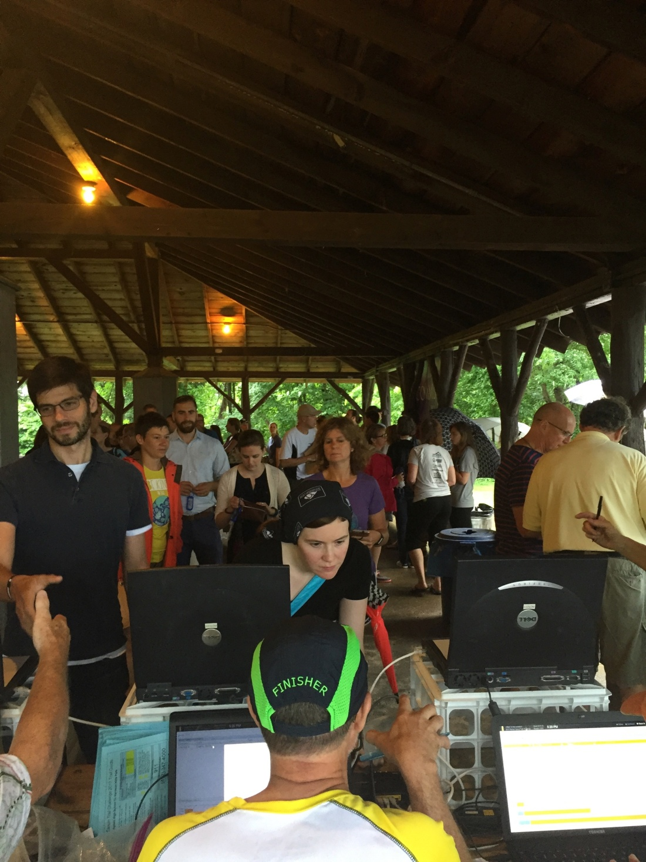
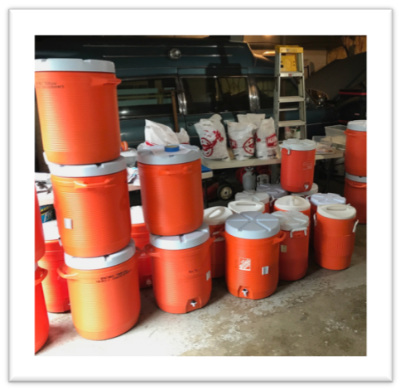
Day Before the Challenge
  You have the opportunity to check-In and pick up your fob the night before at North Park at the Harmar Shelter (by swimming pool) between 5 – 8 p.m.
HYDRATE some more.

Slide 40
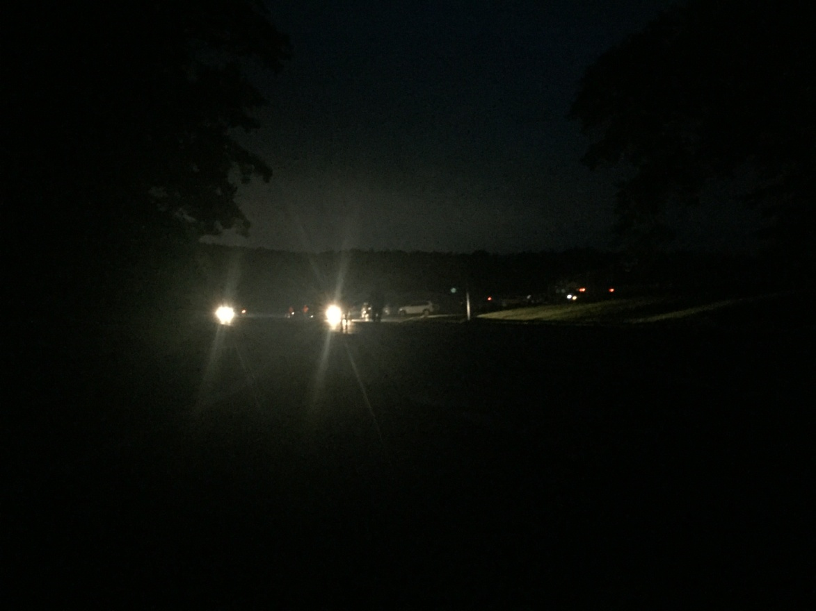
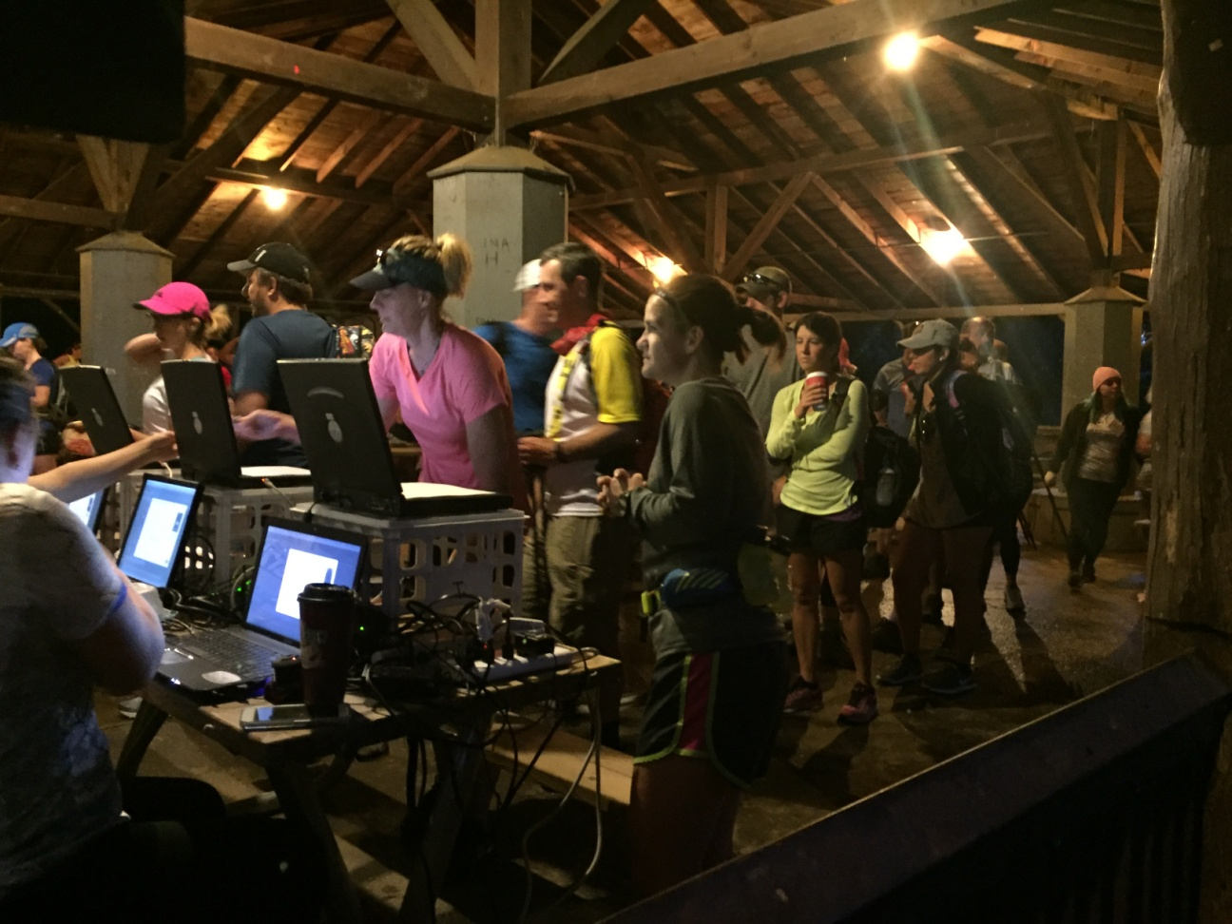
If you can’t make it the night before, you can register before the crack of dawn
Registration opens at 5:00 AM.

Slide 41
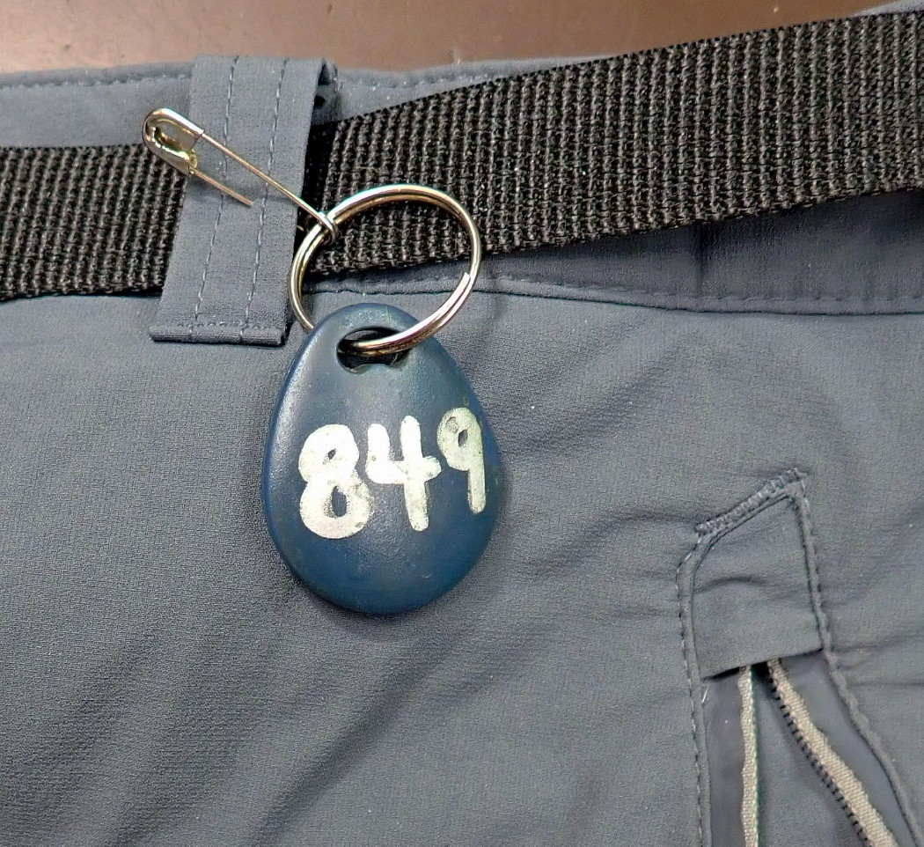
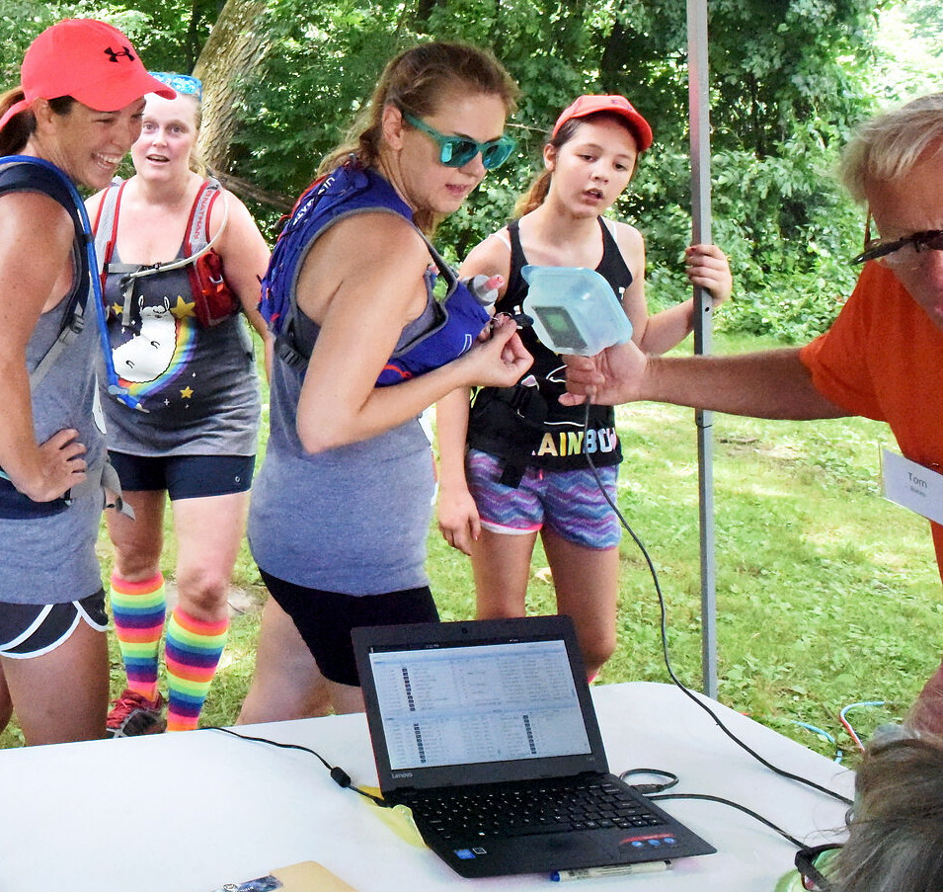
Please make sure that your FOB (Tracking Tag) is read / Hear your number & name at the start, at the finish, and at each check point !

Slide 42
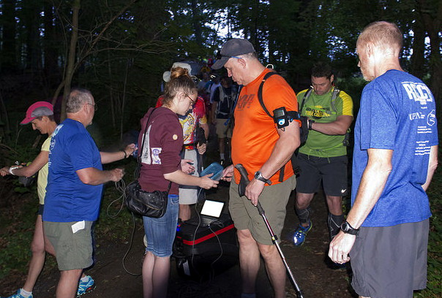
The Big Day – as soon as dawn breaks
Scan in at the beginning and each rest area
Make sure that your FOB is read / Hear your number & name!

Slide 43
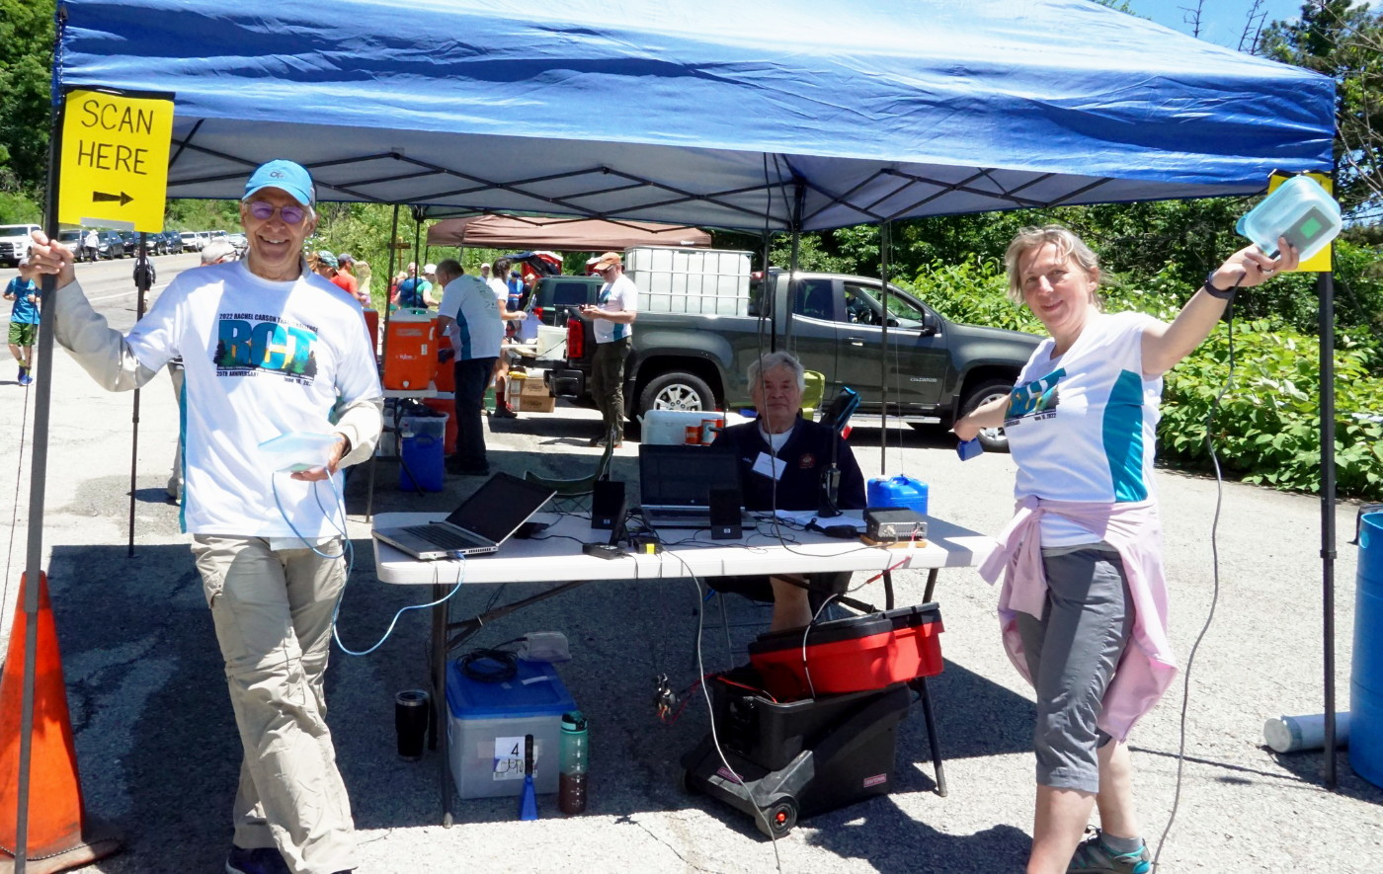
Check Point – Remember to Scan In

Slide 44
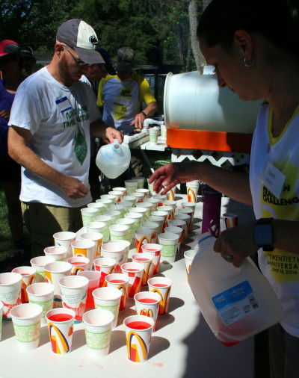
Water / Gatorade !
Hydration is the single most important thing.

Slide 45
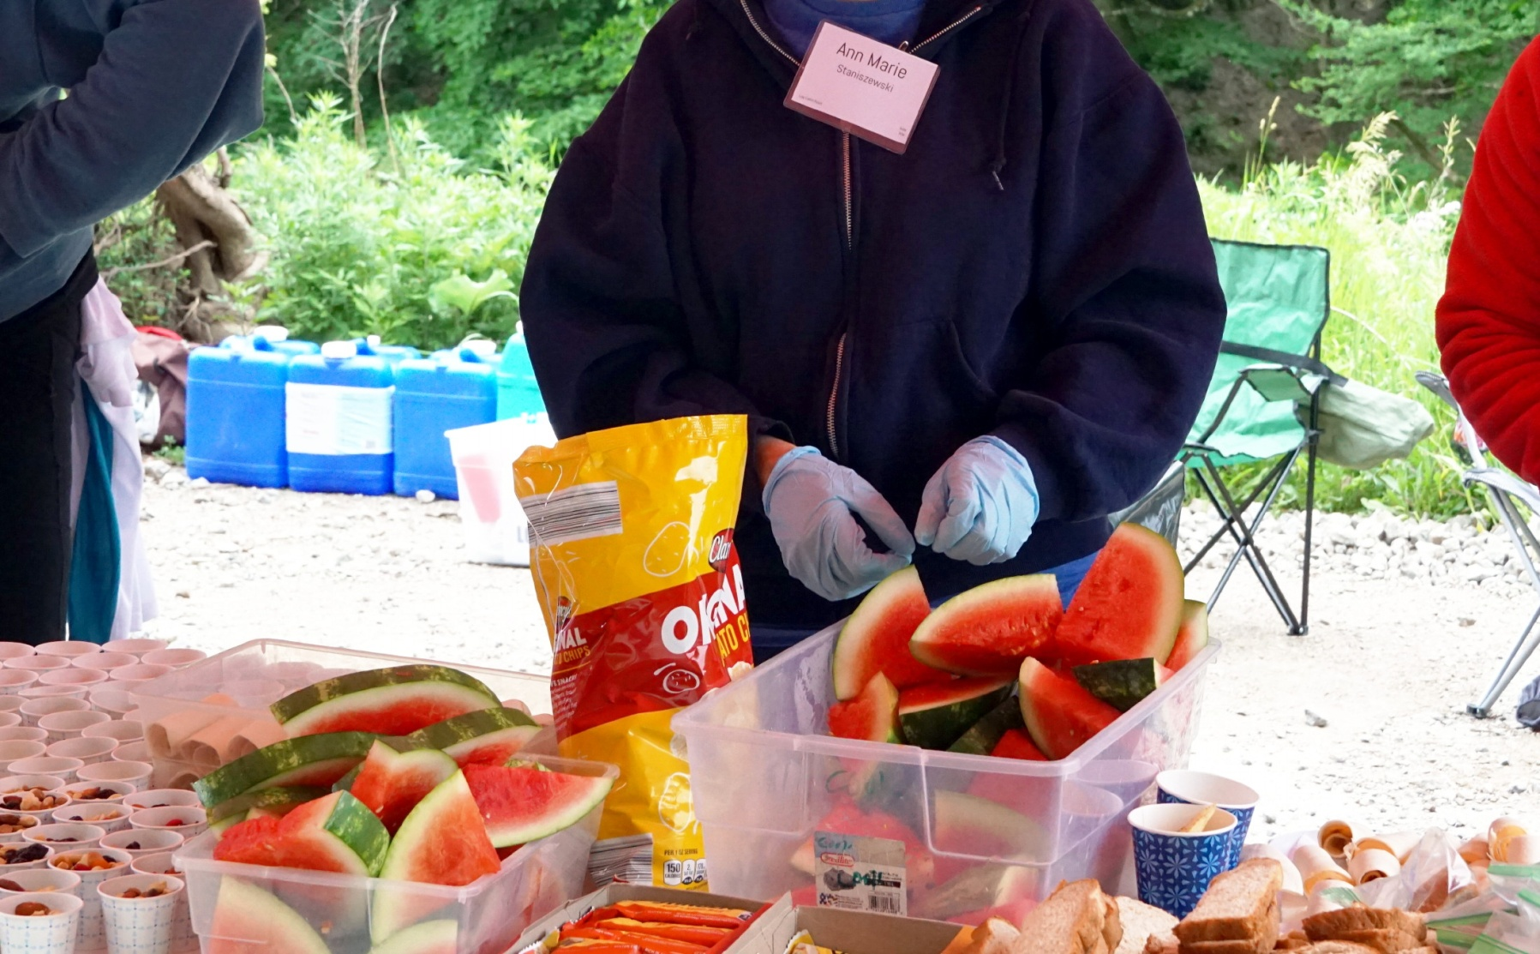
Check Point Items !
A nice variety / you do not need to bring much with you

Slide 46
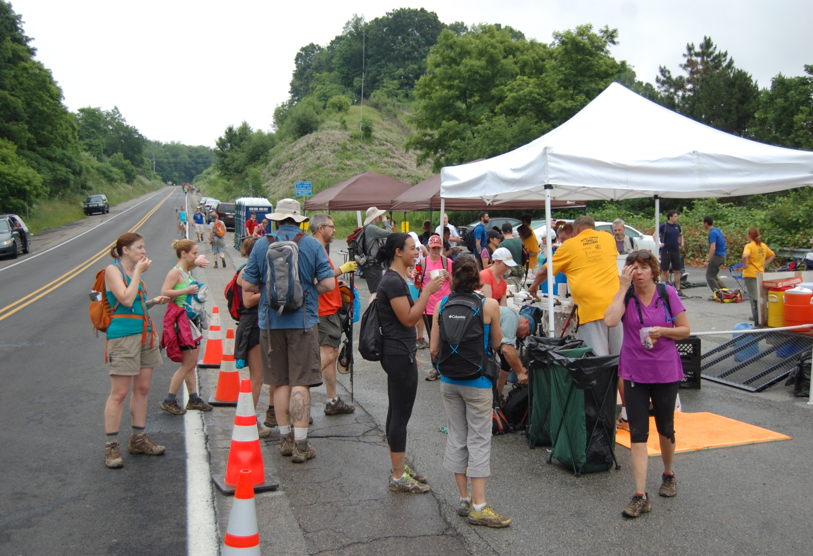
Bull Creek Check Point ( Fourth One ) – In 2024 you will veer up to the right in to the woods instead of staying on the road. .

Slide 47
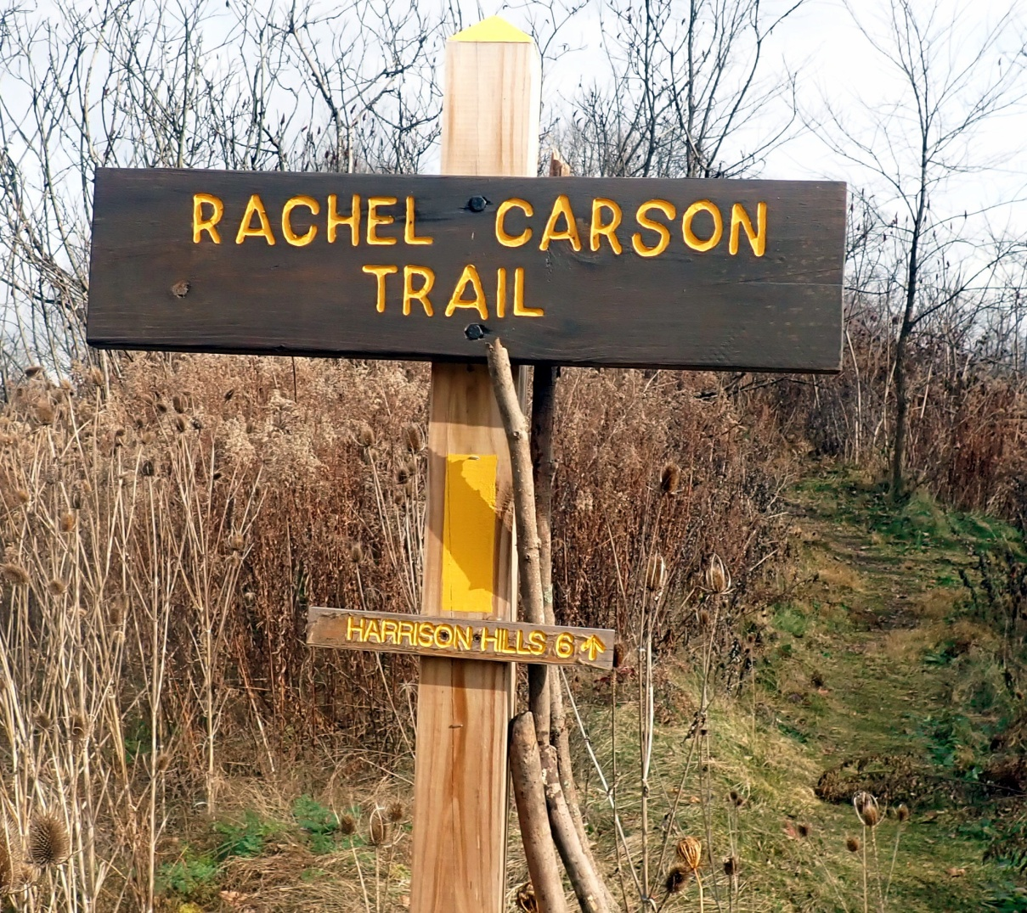
Bull Creek Check Point ( Fourth One ) – In 2024 you will veer up to the right in to the woods instead of staying on the road.

Slide 48
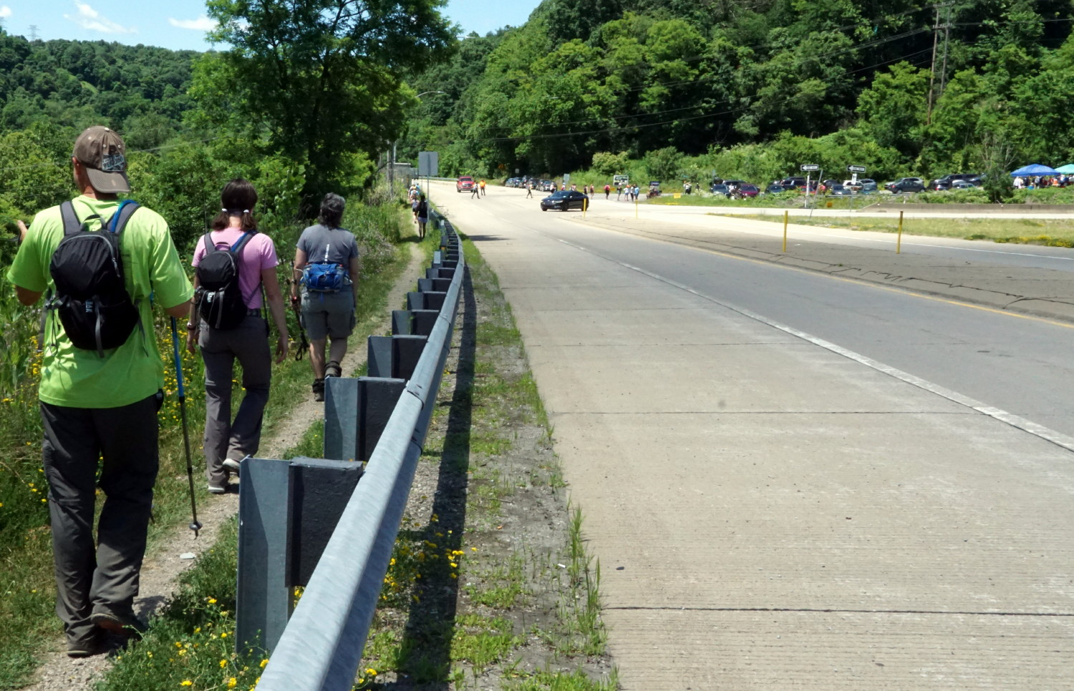
Bull Creek ( 4th. Check point ) in background
to the right

Slide 49
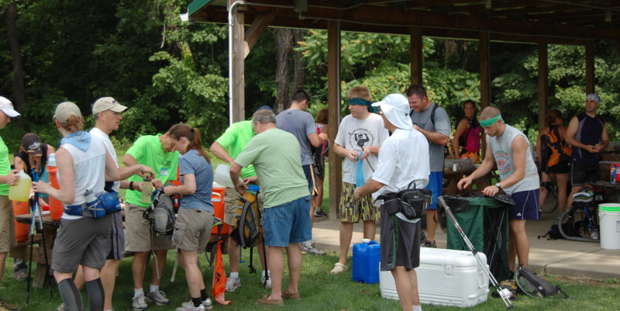
Refreshments (Agan Park Check Point – 3rd. One )
Its been right on the trail for a couple of challenges now !

Slide 50
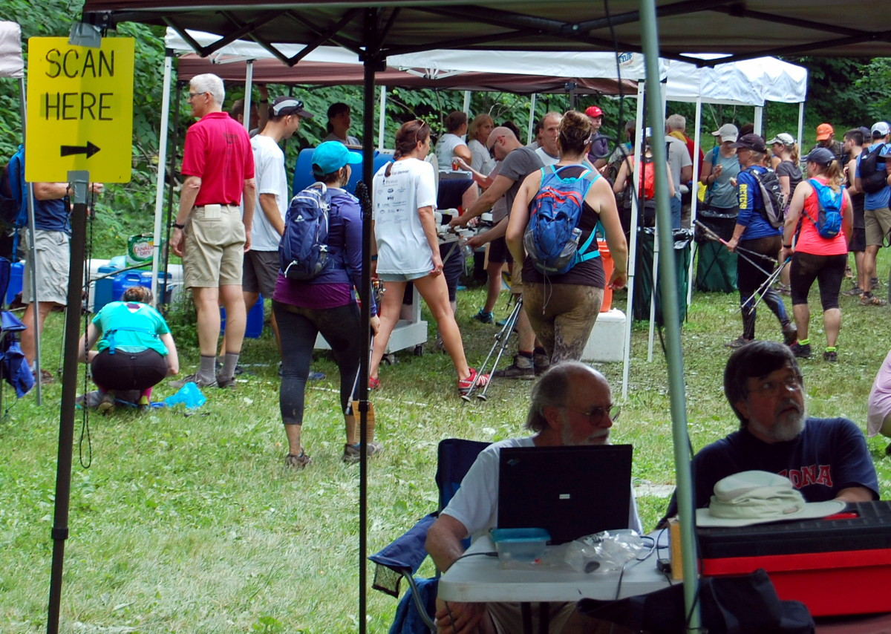
The First (1st) Check Point – Shaffer Road

Slide 51
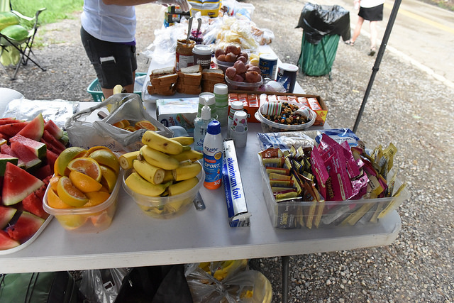
Check Point Nutrition Selections:

Slide 52
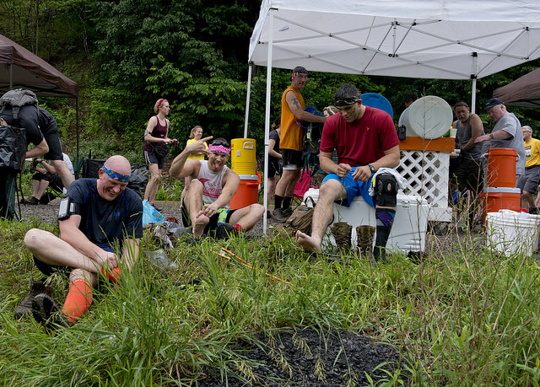
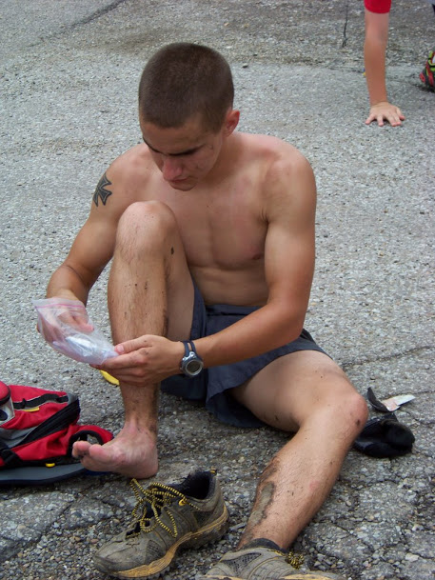
First aid on the go

Slide 53
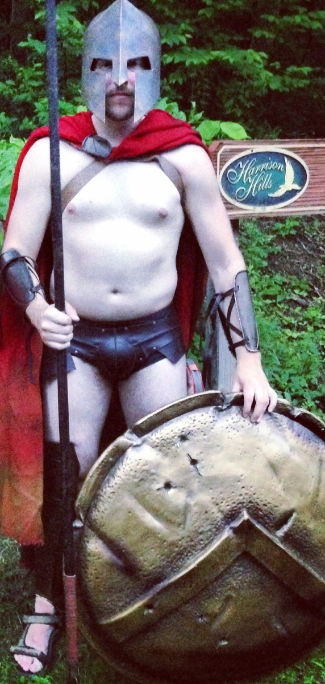
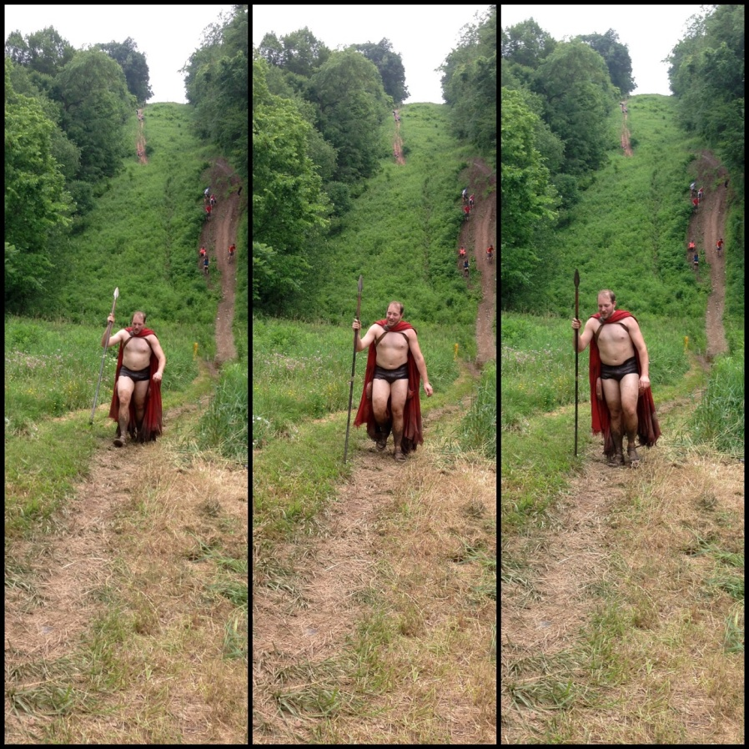

What NOT to bring
  Bluetooth speakers (*headphones are great)
  A friend who isn’t registered
  Your four legged friends
  The kitchen sink

Slide 54
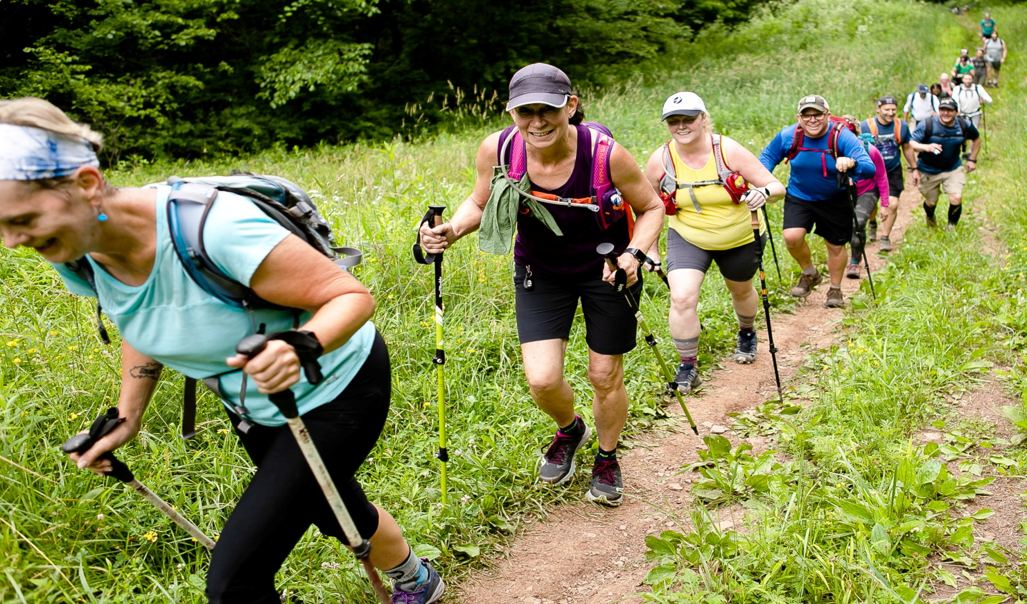
The hills are alive with the sound of huffing and puffing

Slide 55


water hazards – many creek crossings during the day !

Slide 56

One of many creek crossings
Avoid the water !

Slide 57

One of many creek crossings
Avoid the water or not !

Slide 58

Rocky Dell Area - 1 mile or so from the start

Slide 59

Mud Mud so Much Mud Some Years !

Slide 60

Might Need New Shoes !

Slide 61

Enjoying Back Side of Log Cabin Hill

Slide 62

Very muddy & slippery Murray Hill
Hopefully not this slippery in 2024

Slide 63

What - Another crazy steep hill ??

Slide 64

Log Cabin Hill / 2024 Going Up right after Check Point #2

Slide 65

Log Cabin Hill / 2024 Going Up Up Up after Check Point #2

Slide 66

Safe at second !

Slide 67

2024 – Up Route 910 / Cross the Turnpike on Bridge

Slide 68

2024 – Heading down towards Saxonburg Blvd then Emmerling

Slide 69

Checking Water Supply ( is that really water ? )

Slide 70

Where oh Where is this on the Rachel ?

Slide 71

Past Emmerling Park – working towards Rich Hill

Slide 72

Past Emmerling Park – working towards Rich Hill

Slide 73

Burtner Hill – this year going up

Slide 74

Past Burtner Burtner Hill

Slide 75

Start of Homestead Challenge - Springdale – near the high school & RC Homestead / Remember to have your FOB scanned

Slide 76

”HALF WAY” POINT and start of Homestead Challenge
Springdale – near the high school & RC Homestead
MARION AVE / SPRINGDALE

Slide 77

”HALF WAY” POINT of Full Challenge and near start of Homestead Challenge
Springdale – RC Homestead / Marion Ave.

Slide 78

Out of the woods they come

Slide 79

Out of the woods they come ( so very green )

Slide 80

All by myself. About 5 miles from the finish

Slide 81

Some rutted ( dirt bikes ) terrain

Slide 82

A nice walk along Shaffer Run Road - near 1st. Check point

Slide 83

Emmerling Park – Cheering Dad on.

Slide 84

A nice walk through the woods

Slide 85

Follow the Light or is that Don’t follow the light ?
( Just before the Log Cabin (2nd. ) Check Point )

Slide 86


Hills & more hills of all types and sizes

Slide 87

Sharing the road

Slide 88

Sharing the road

Slide 89

Horse Farm Area (Fence hazard)
Please always respect the private properties we cross !

Slide 90

Even the kids are taking on the challenge

Slide 91

Railroad Tracks – one of many surfaces traversed !

Slide 92

A Hike in the Rain / all conditions !

Slide 93

Hiking or Singing in the Rain !

Slide 94

One of a thousand hills !

Slide 95

Log Cabin Hill ( Mudder ) !

Slide 96

Climbing Log Cabin Hill just after check point !

Slide 97

Steep Rooty Terrain !

Slide 98

Family challenge participants

Slide 99

THE END ! Congratulations to all who went out.

Slide 100

Whoo hooooooo

Slide 101

THE END

Slide 102

THE END

Slide 103

THE END
Ralph Swain 81 years young finishes
the Homestead Challenge

Slide 104

A muddy finisher

Slide 105

Just a little tired !

Slide 106

Picnic at North Park -- Harmar Shelter

Slide 107

Picnic at North Park

Slide 108
Oldest & Youngest Females to Complete the Full Rachel Carson Trail Challenge
2015: Youngest Female | Katie Schwartzman | 13 | 14 35 25
2016: Youngest Female 2021: Youngest Female 2017: Youngest Female 2023: Youngest Female | Katie Schwartzman Lorelei Lehman Esmee de Cortie Paula, Ella | 14 14 16 18 | 14 08 29 13 20 49 12 59 56 12 46 22
2015: Oldest Female | Beverly Yates | 73 | 11 39 38
2016: Oldest Female 2022: Oldest Female 2014: Oldest Female 2021: Oldest Female 2021: Oldest Female | Gretchen Herda Terri Thompson Kay Walburn Terri Thompson Tracey Johnson Brookins | 69 66 66 65 65 | 13 24 27 13 45 01 14 11 53 13 04 39 12 25 10
2023 Oldest Female 2023 Oldest Female 2023 Oldest Female 2023 Oldest Female 2023 Oldest Female | Johnson Brookins, Tracey Thompson, Barb Thompson, Terri Tatus, Betty Cully, Debra | 67 67 67 68 70 | 12 33 21 13 35 14 14 07 03 14 13 14 13 10 47

Slide 109
Oldest & Youngest Males to Complete the Full Rachel Carson Trail Challenge
2014: Youngest Male | James Urbanic (Ohio) | 12 | 12 14 20
2022: Youngest Male 2013: Youngest Male 2015: Youngest Male 2016: Youngest Male 2019: Youngest Male 2019: Youngest Male 2023: Youngest Male | Leo Urbancic Jonah DeCortie Avery Bursick James Urbancic Daniel J. Fritsch Owen Ostrowski Nowak, Bailie Walker | 13 14 14 14 14 14 16 | 10 37 12 11 16 31 10 44 33 09 47 59 13 46 17 14 22 08 12 12 57
2021: Oldest Males | James R. Antoniono Bob Reiland Tom Armstrong Ken Zellars | 75 73 73 72 | 14 52 02 13 20 32 13 09 23 12 38 32
2022: Oldest Male | James R. Antoniono Tom Armstrong Bob Reiland John Warrick | 76 74 74 72 | 13 40 30 13 34 28 13 31 52 12 13 19
2023: Oldest Males | James R. Antoniono Tom Armstrong Bob Reiland | 77 75 75 | 14 09 42 13 38 34 13 51 57

Slide 114
Hey Paul
I remember when you two gave your presentation at REI earlier this year about the Rachel Trail Challenge.. You mentioned that the funniest part was how many people who are tired, beaten up, and exhausted said "I'll do it again next year"
Well, when I got home, after competing the full challenge for the first time, I barked,
"That was the worst and stupidest experience ever! Why did I sign up for that! Never let me make such terrible decisions!"
I was in SOOO much pain head to toe..and beyond exhausted. Miserable.
But in the morning, I said to her- "Call me crazy, but I’m doing that again next year."
And I proceeded to check out better shoes on-line for next year that morning.
HA!!! You were right!
Most amazing event!
Mark Loebach

Slide 115

The nineteenth annual Baker Trail UltraChallenge will take place on Saturday August 24, 2024. The UltraChallenge is a 50-mile ultramarathon on the Baker Trail.
Unlike the Rachel Carson Trail Challenge, this is a footrace; the "challenge" is for you or your relay team to win, or at least finish in 14 hours or less!
In 2024 we'll run the Central section. Each year, a piece of a unique three-piece medal will be awarded to all individual finishers. When a participant has completed all three sections, they'll receive a handsome commemorative holder to display all three medals.
The race starts at 6:30 AM; the deadline for finishing is 8:30 PM. The finish line is near Smicksburg, PA. Individuals as well as relay teams of up to 5 members may register. https://www.rachelcarsontrails.org/events/ultrachallenge

Slide 116


Slide 117


Slide 118

Rachel Carson Trails Conservancy Geotrail
The Rachel Carson Trails Conservancy Geotrail was designed to introduce people to the Rachel Carson Trail by combining hiking with the fun sport of geocaching. Geocaching is often referred to as the “world’s largest treasure hunt.”
https://www.rachelcarsontrails.org/trails/geotrail

Slide 119

100 Mile Quest
Commit to hike a total of 100 miles on Conservancy trails (the Rachel Carson Trail, the Baker Trail, and/or the Harmony Trail) within 365 days from today and earn a cool, colorful RCTC 100 Mile patch and certificate! You can hike any of these trails any number of times to accrue miles.
https://www.rachelcarsontrails.org/trails/quest100

Slide 120

What on earth is Karma???
We believe karma is a fair and objective way of determining the contribution an individual has made toward achieving the Goals of the Conservancy.
Serves as a tie breaker for event entry if nearly sold out / more registrants than spots available

Slide 121

Want your name on a T-shirt ???
Social Media Recognition
Or to just help our organization
https://www.rachelcarsontrails.org/donate

Slide 122




We can also be found on social media
https://www.facebook.com/rachelcarsontrails/
https://www.flickr.com/photos/rachelcarsontrailsconservancy/
https://www.instagram.com/rachelcarsontrail/
https://twitter.com/rachelcarsontc

Slide 123
More information
Kathleen Ganster: kganster@verizon.net
Paul Sauers: sauersp@aol.com
Cell: (412) 779-8987
For more information remember to visit our website:
https://www.rachelcarsontrails.org/
.
https://www.rachelcarsontrails.org/events/challenge/rctc23

